Slide 1
LLM-Based Innovation Screener
Automated research & feasibility evaluation tool with Gemini & public web data.
Sneha Maurya
MS DS - LLM for Business Applications (Fall 2025)

Slide 2
Problem Statement
Slow and Manual: Experts use 1-2 weeks
Limited scale: Technical Bottlenecks prevent screening of multiple ideas simultaneously
Outdated data: Static research that doesn’t reflect real time market search
Subjective search: Inconsistent across different people’s evaluation.

Slide 3
Solution Overview
From Raw idea to structured overview. The core innovation included hybrid AI system combining Large Language models th real-time web search.
Idea Input (Rough/ first thought)
Multi-API Data Gathering:
(System Queries multiple sources)
AI Analysis: Gemini 1.5 Pro summarises,reasons, clusters across multiple results for feasibility.
Report Generation: Professional Report (HTML)
Or
JSON

Slide 4
Tech Stack
Frontend Layer:
Next.js 14 - React framework
Typescript - Type Safety
Tailwind CSS - Professional Style
Backend & Processing:
Vercel Functions - Serverless execution for API calls
API Orchestrations - Combines Google search, Github, arXiv search endpoints
Semantic filtering - keeps only contextually relevant data for Gemini input
AI Engines:
Gemini 1.5 Pro - Advanced Reasoning & analysis
Optimised Prompts- Consistent results
Fallback Handling -Prevents pipeline failure during rate-limit or null-response cases

Slide 5
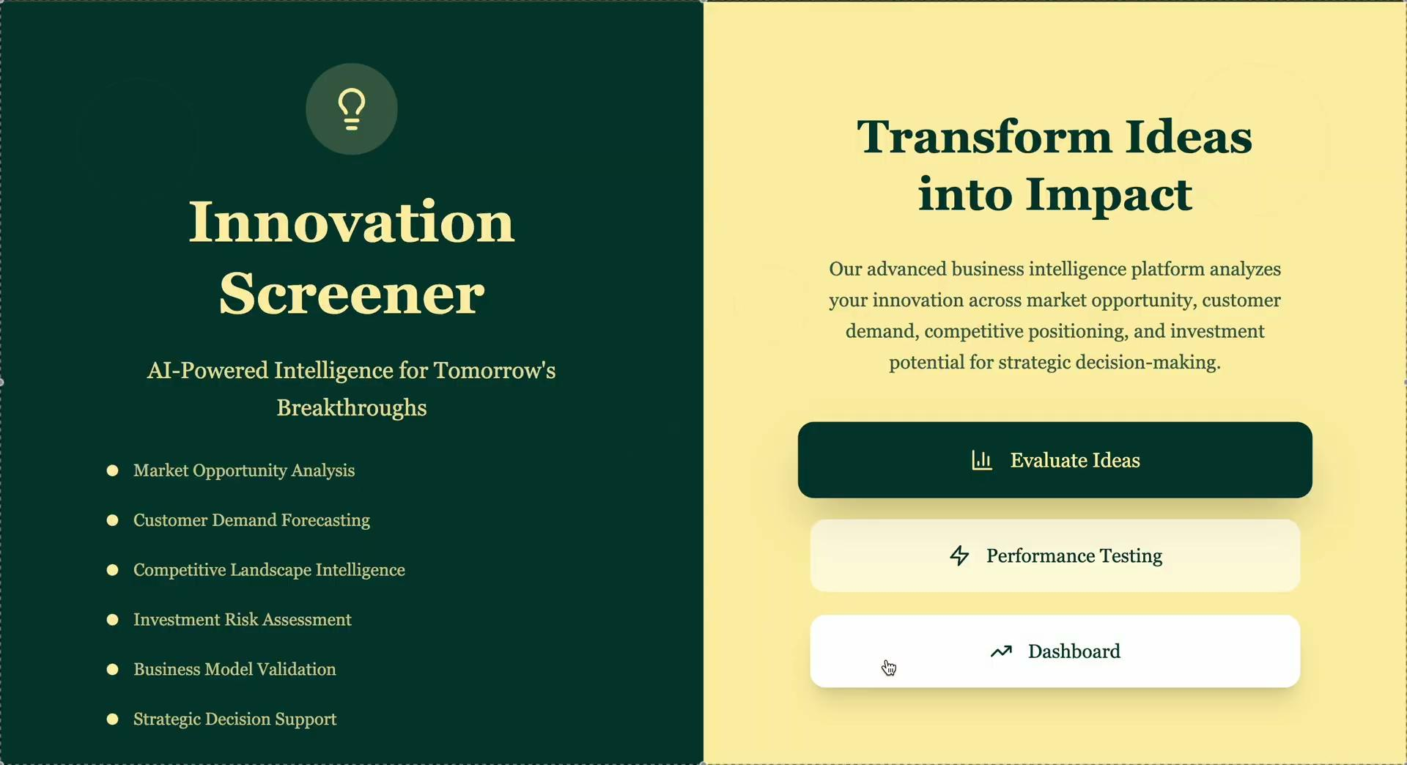
Thank you! Let’s look at our demo now!

Slide 6
Key Learnings while building!
Built multi-API orchestration into a single call for speed and reliability.
Learned how to design prompt chains that maintain reasoning coherence.
Added semantic validation between data retrieval - model inference to filter noisy or irrelevant results.
Managed API rate limits and latency through fallback logic and async execution.
Balanced accuracy vs performance in a production-grade Next.js setup

